Slide 1
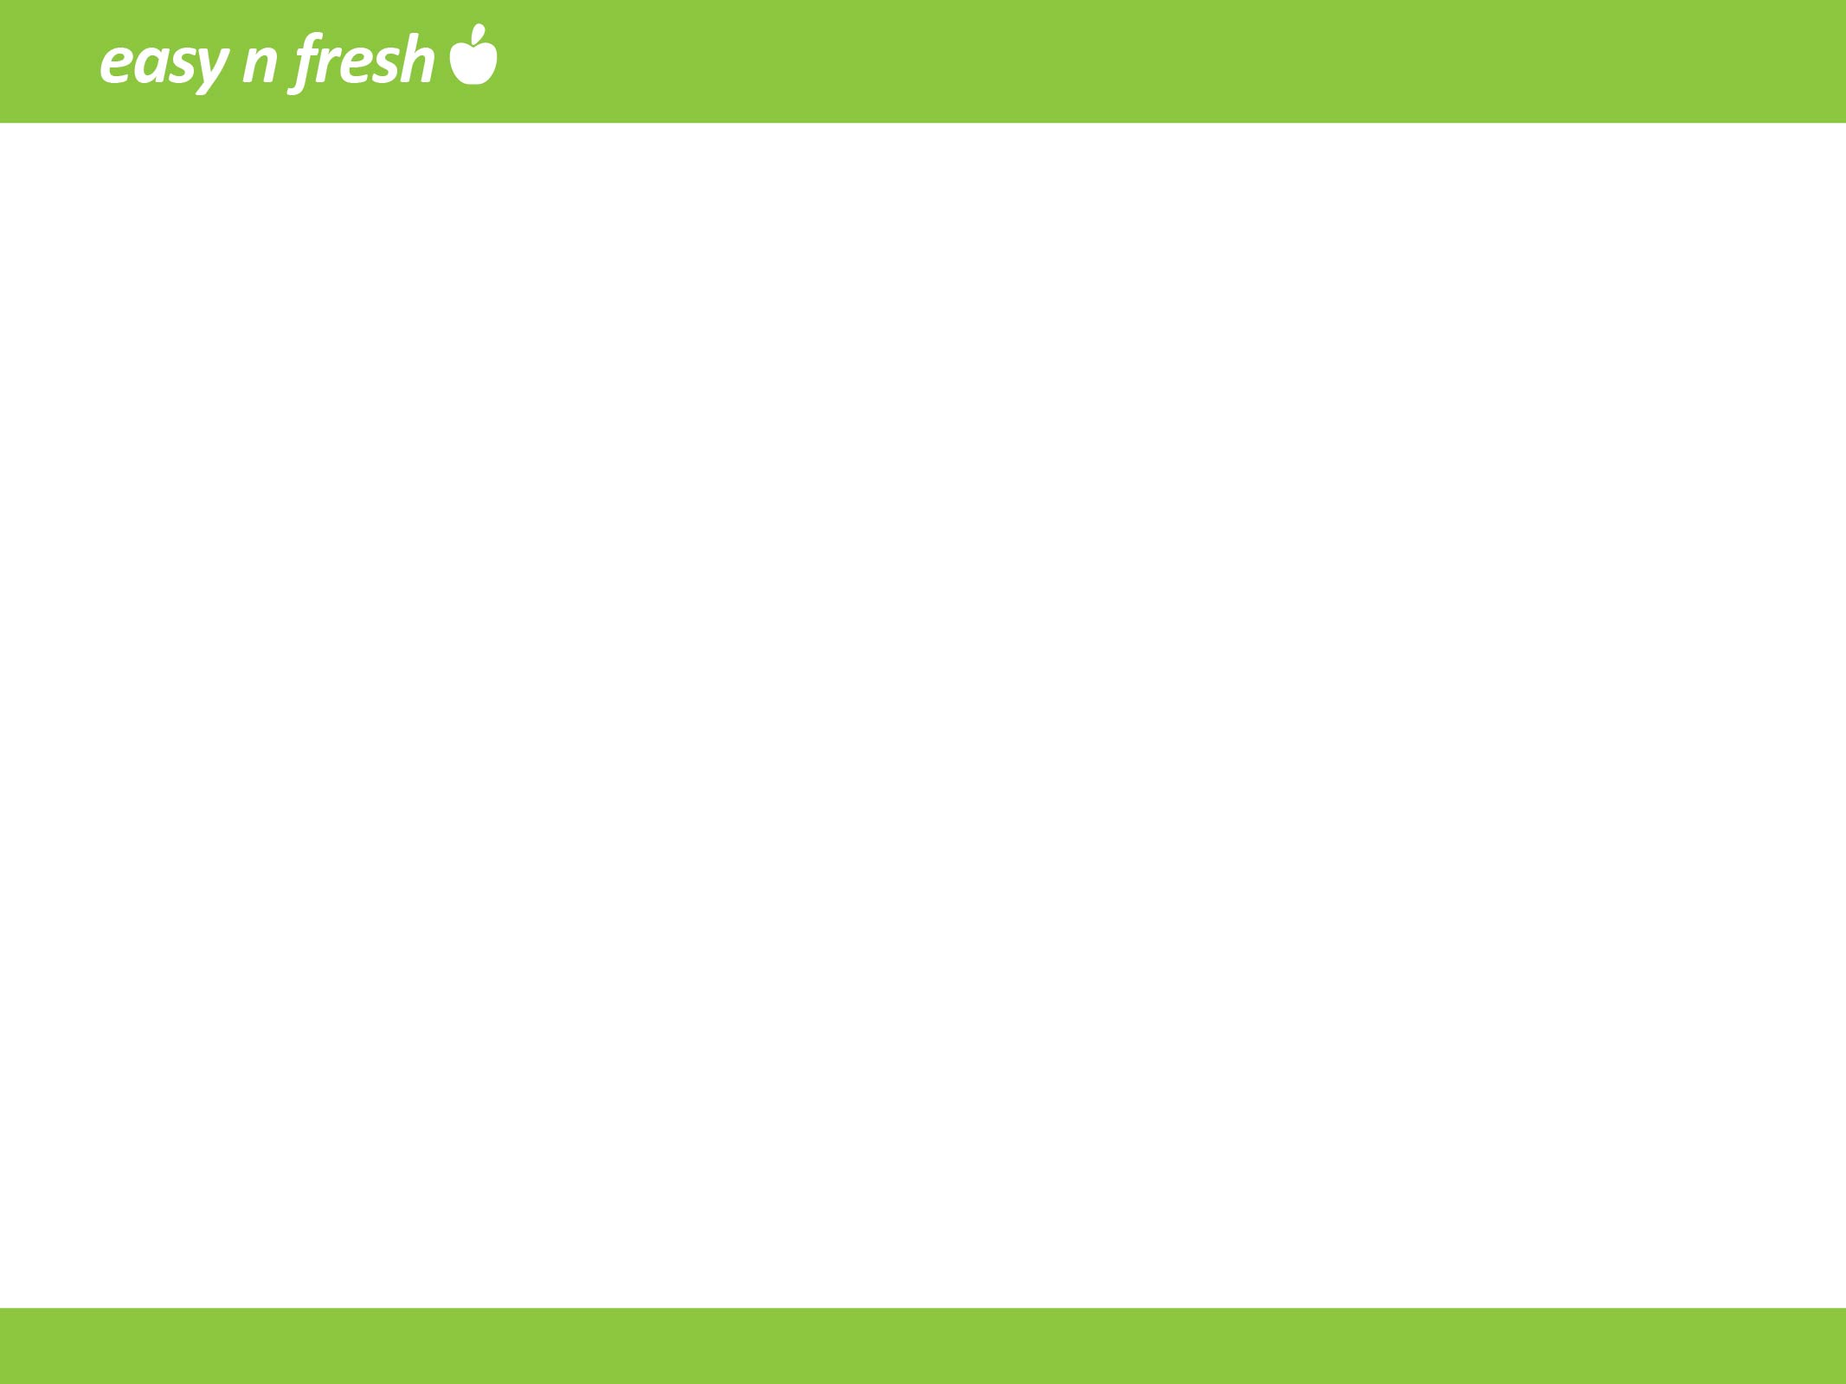
Easy N Fresh
Online delivery system for perishables
Saddam Hussain
Kirthan Vasudevan
Sumit Garg
Sree Lakshmi
Vivek Aggarwal

Slide 2
Sumit Garg

Slide 3
Agenda:
Existing System and its limitation
New System
UML Diagrams
WireFrames
Benefits
Q&A

Slide 4
Problems with Existing System
Time Consuming: Average person spends 5 hours a week on grocery shopping.
Absence of perishable goods delivery
Absence of retailers integration system
Doesn’t provide best coupon on each product
Absence of rewards and coupon integration

Slide 5
New system
Delivery of perishables
Integration of retailers in one platform
Choice of best deal on product
Customer retention using rewards program
Providing specific coupons for products
Flexible delivery options and timings

Slide 6
Sree Lakshmi

Slide 7
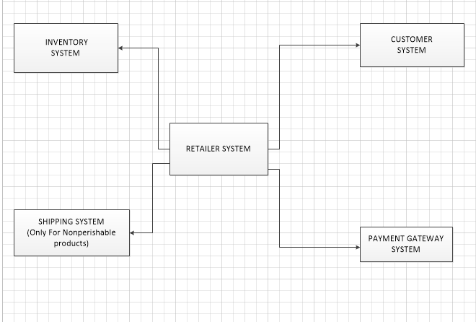
Existing System – Context Diagram

Slide 8
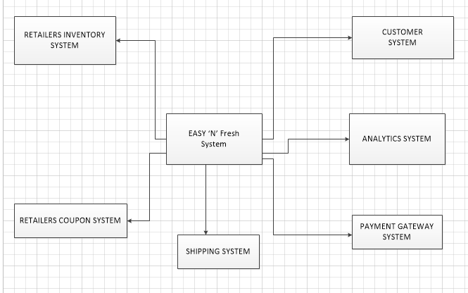
New System – Context Diagram

Slide 9
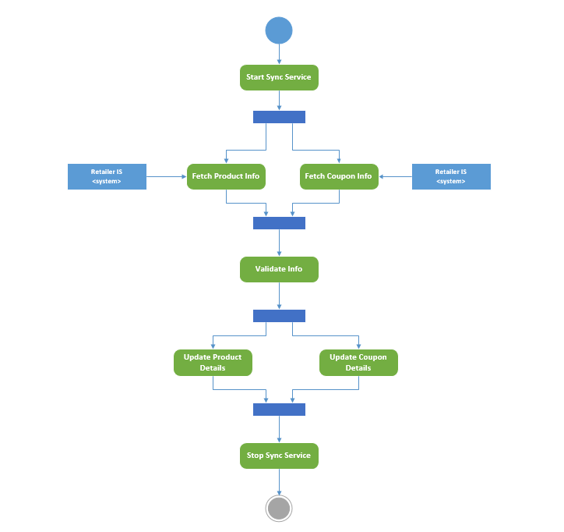
Activity Diagram

Slide 10
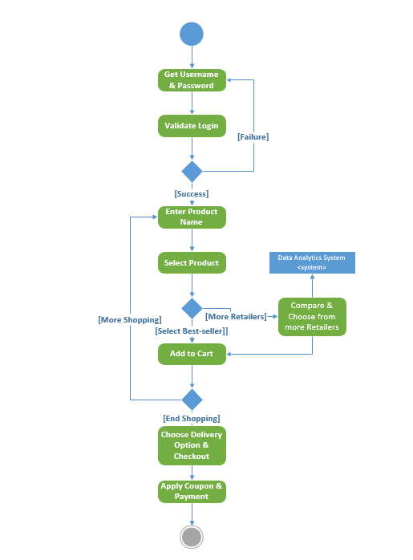

Slide 11
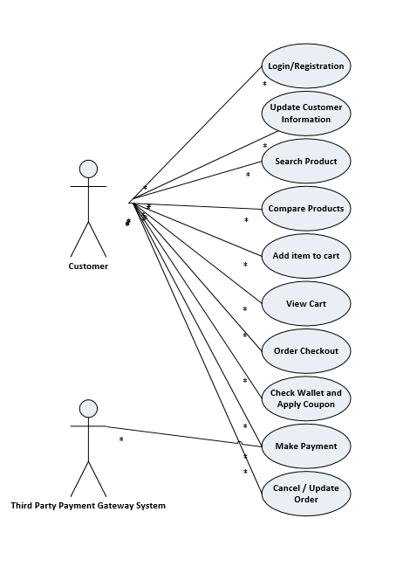
Use Case Diagram:

Slide 12
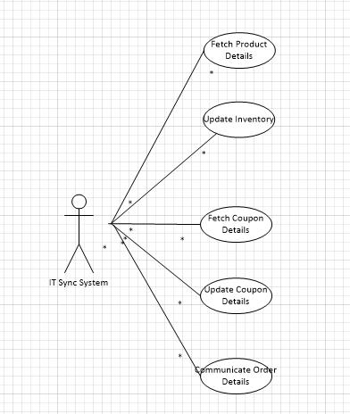

Slide 13
Saddam Hussain

Slide 14
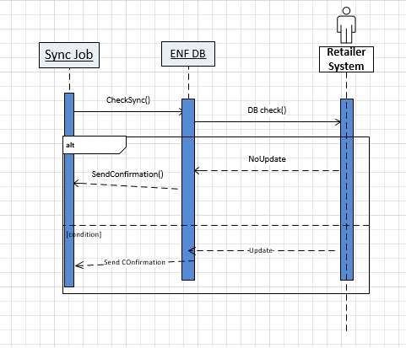
Sequence Diagram:

Slide 15
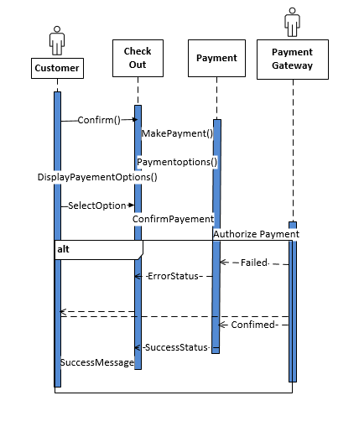

Slide 16
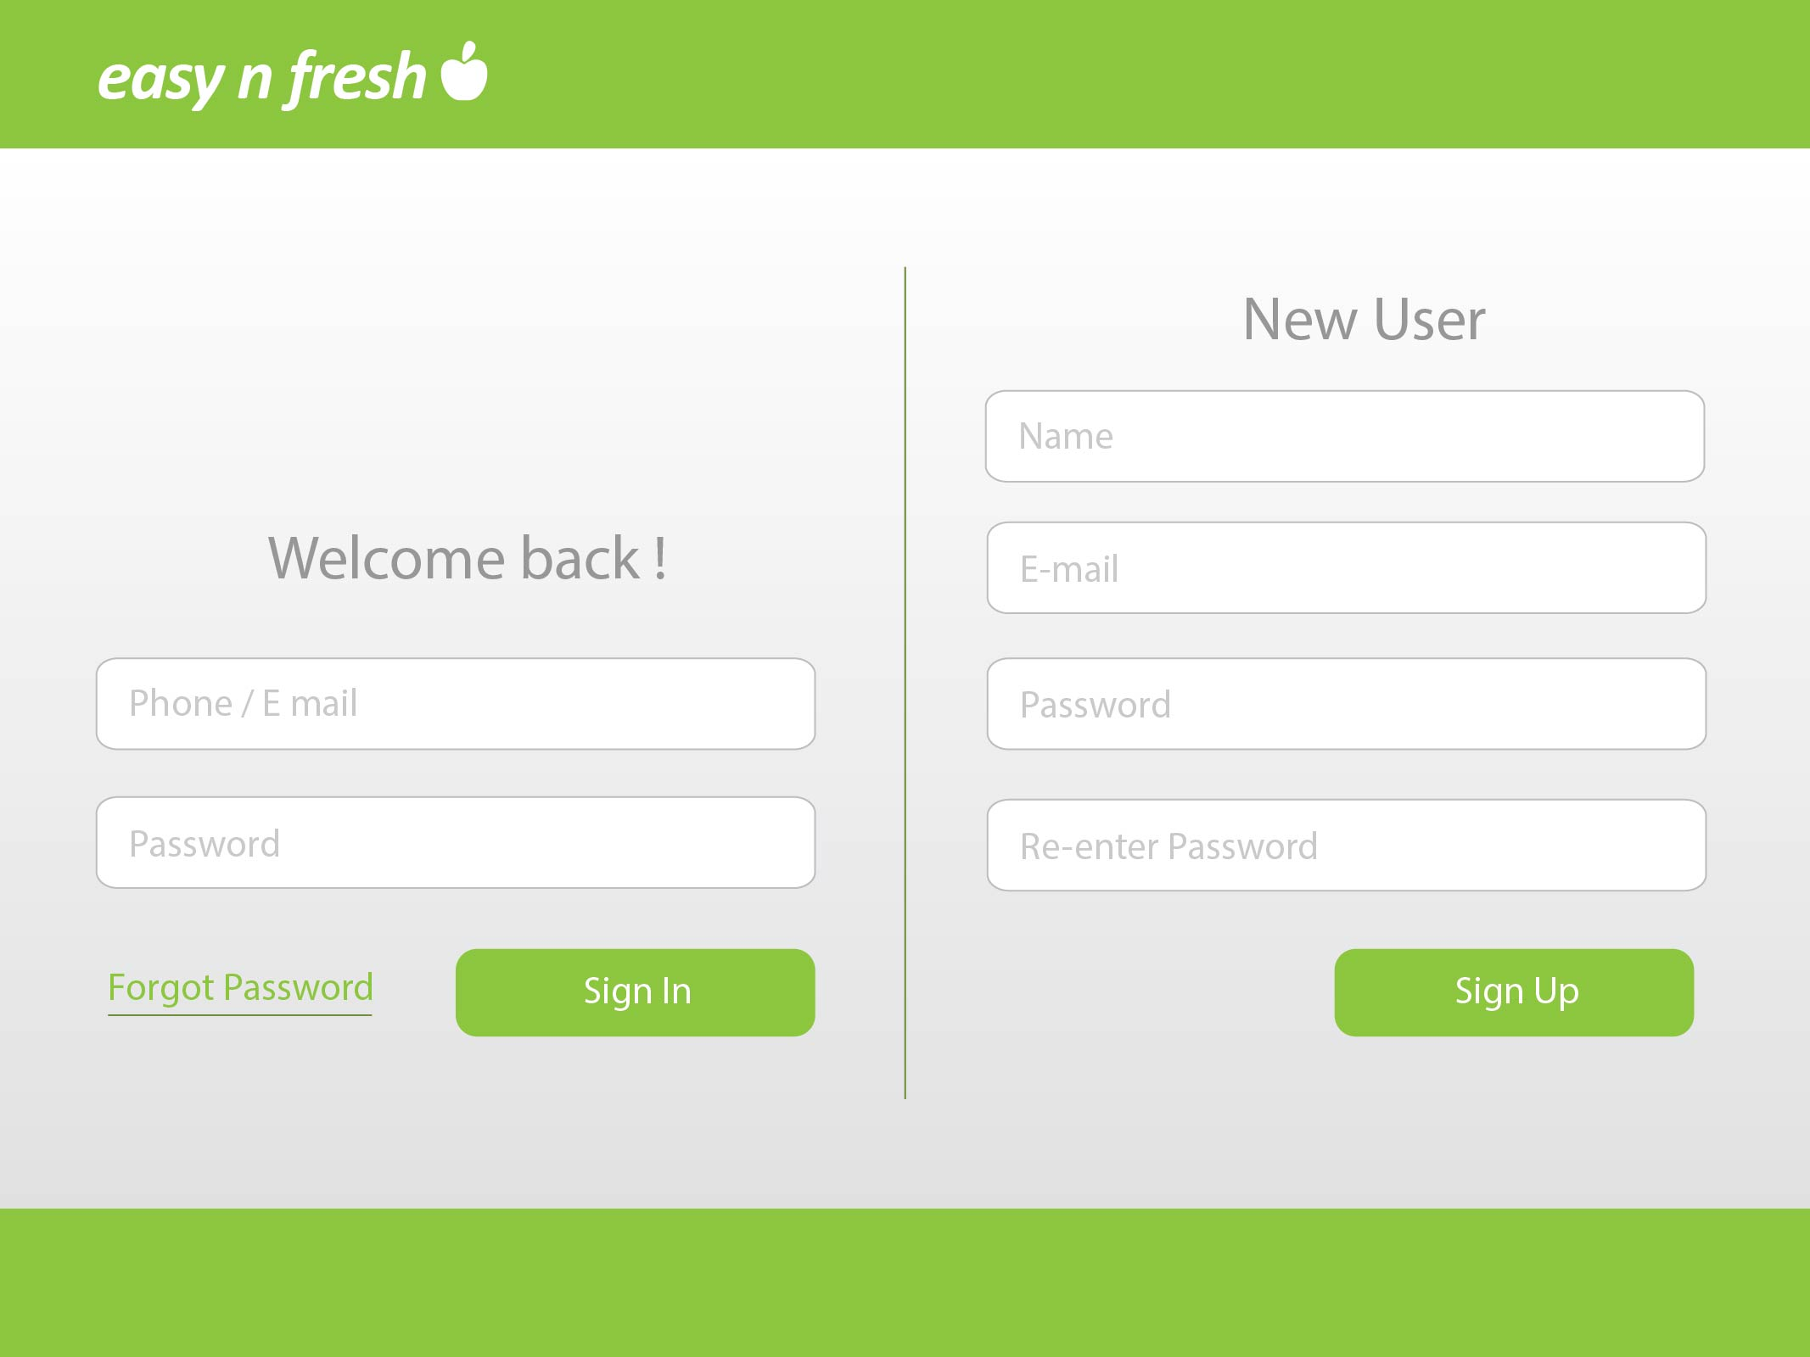

Slide 17
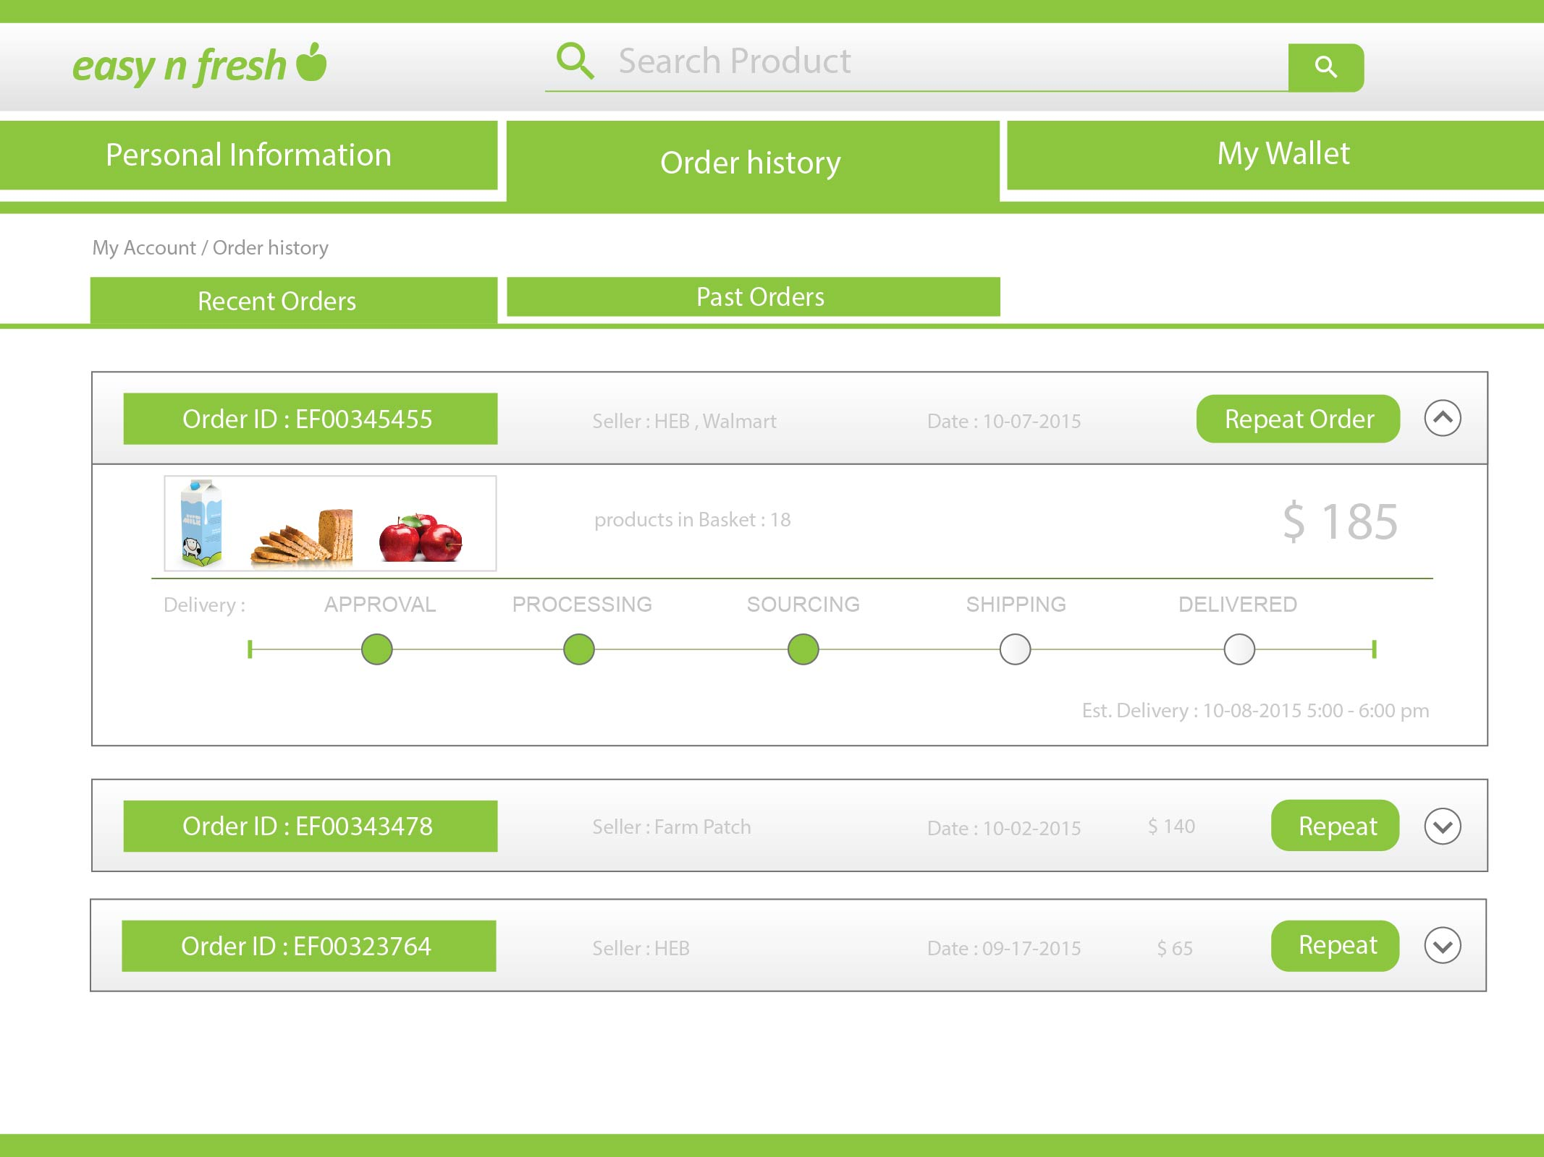

Slide 18
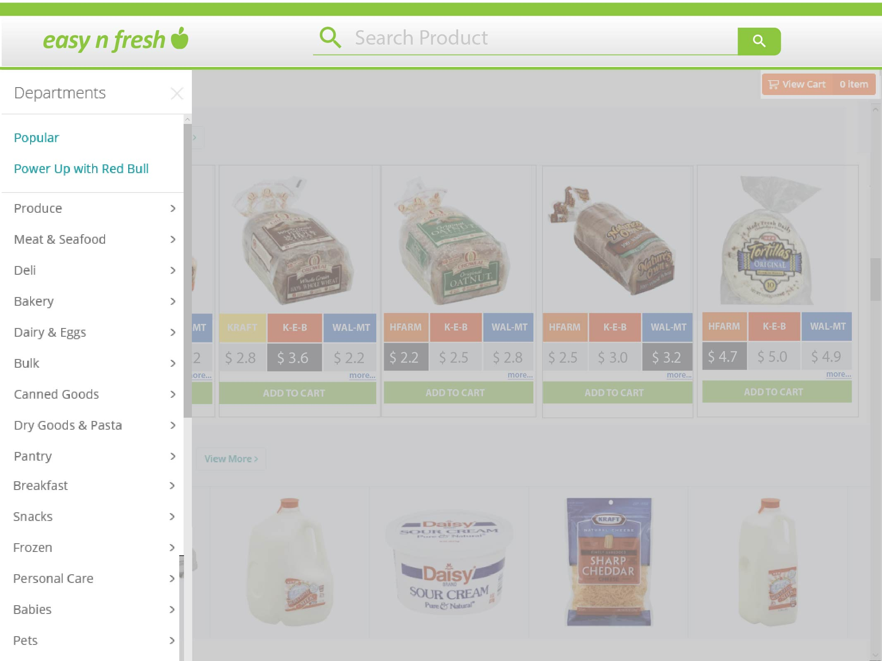

Slide 19
Kirthan Vasudevan

Slide 20
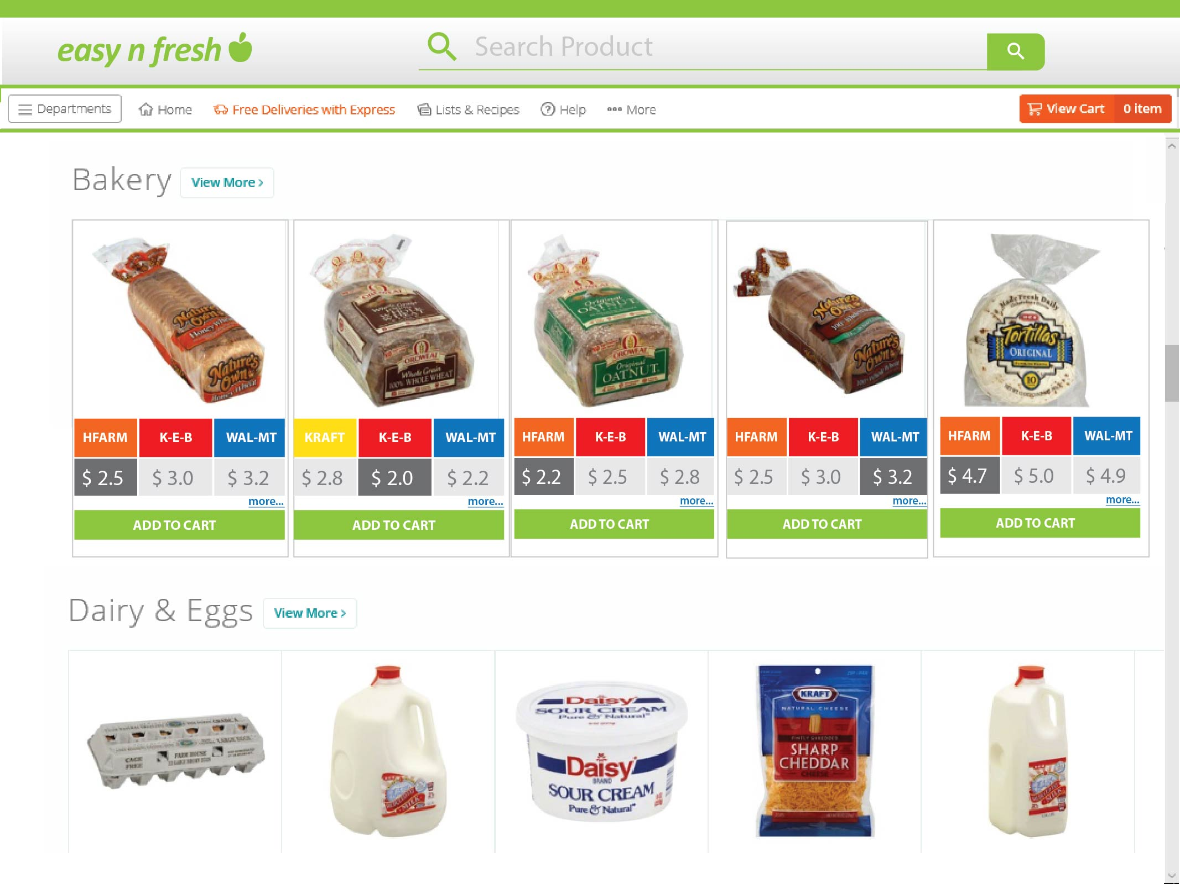

Slide 21
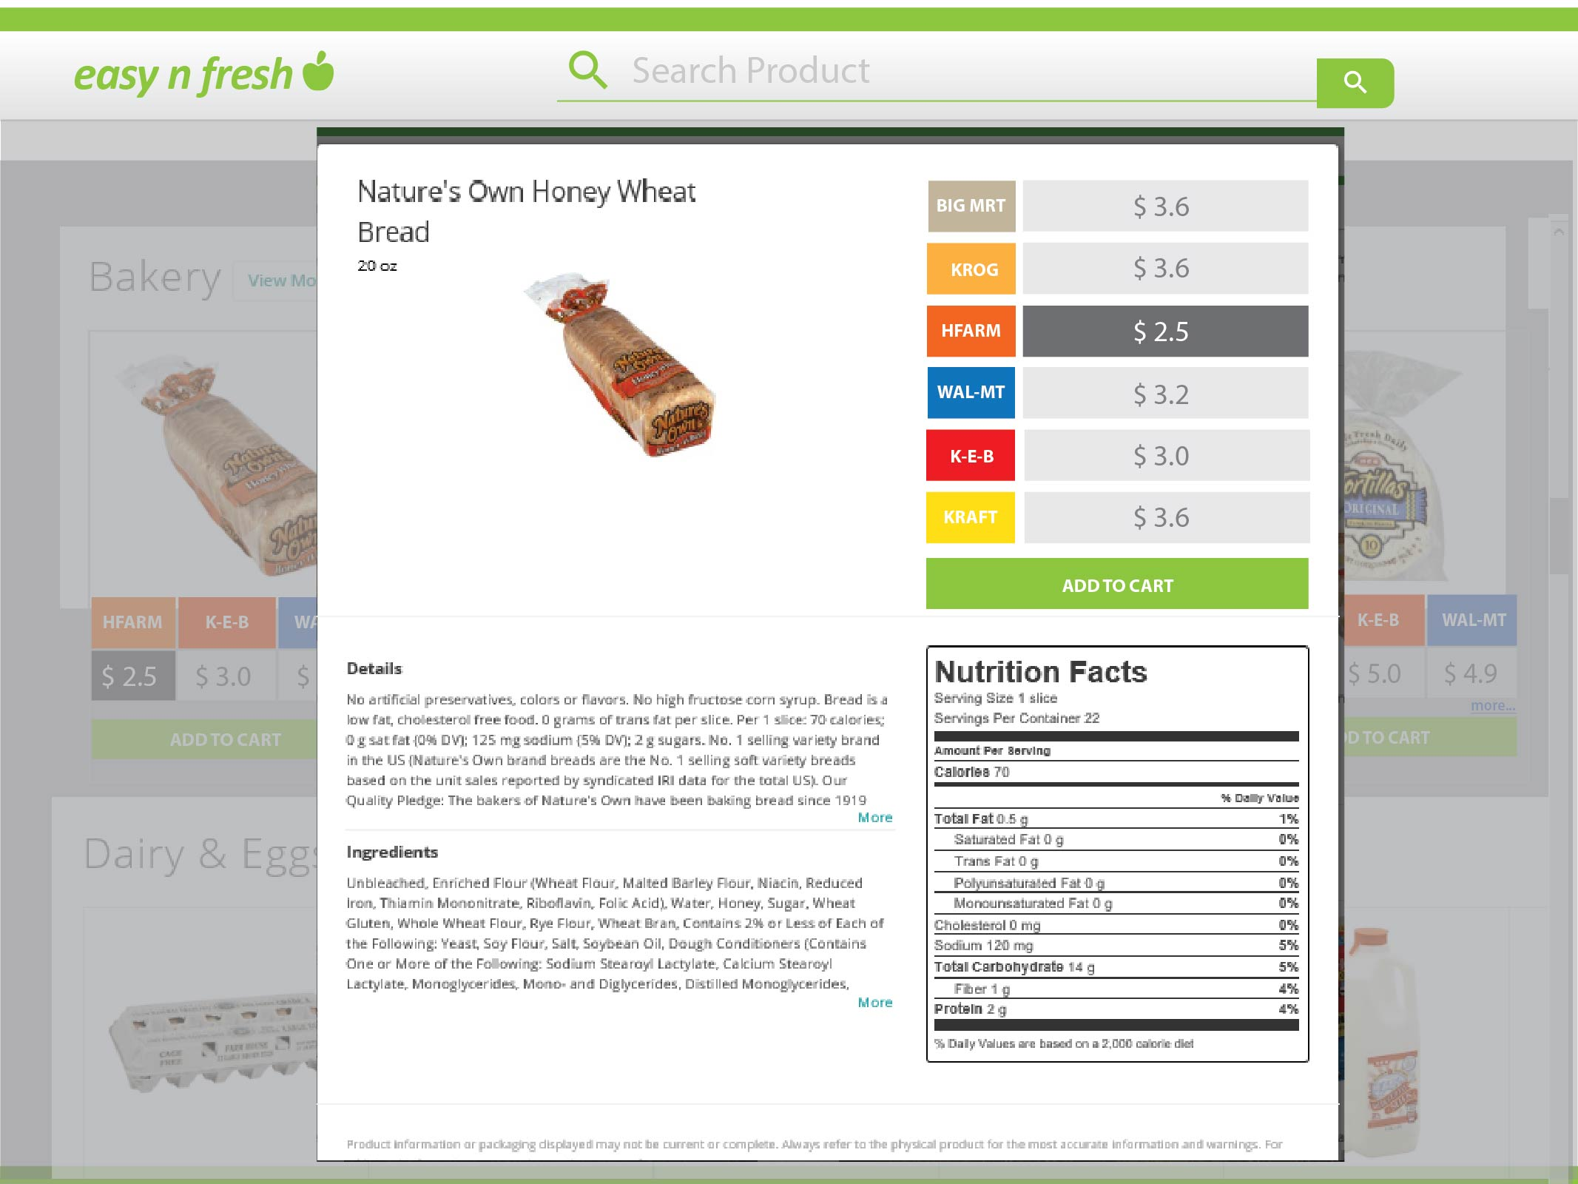

Slide 22
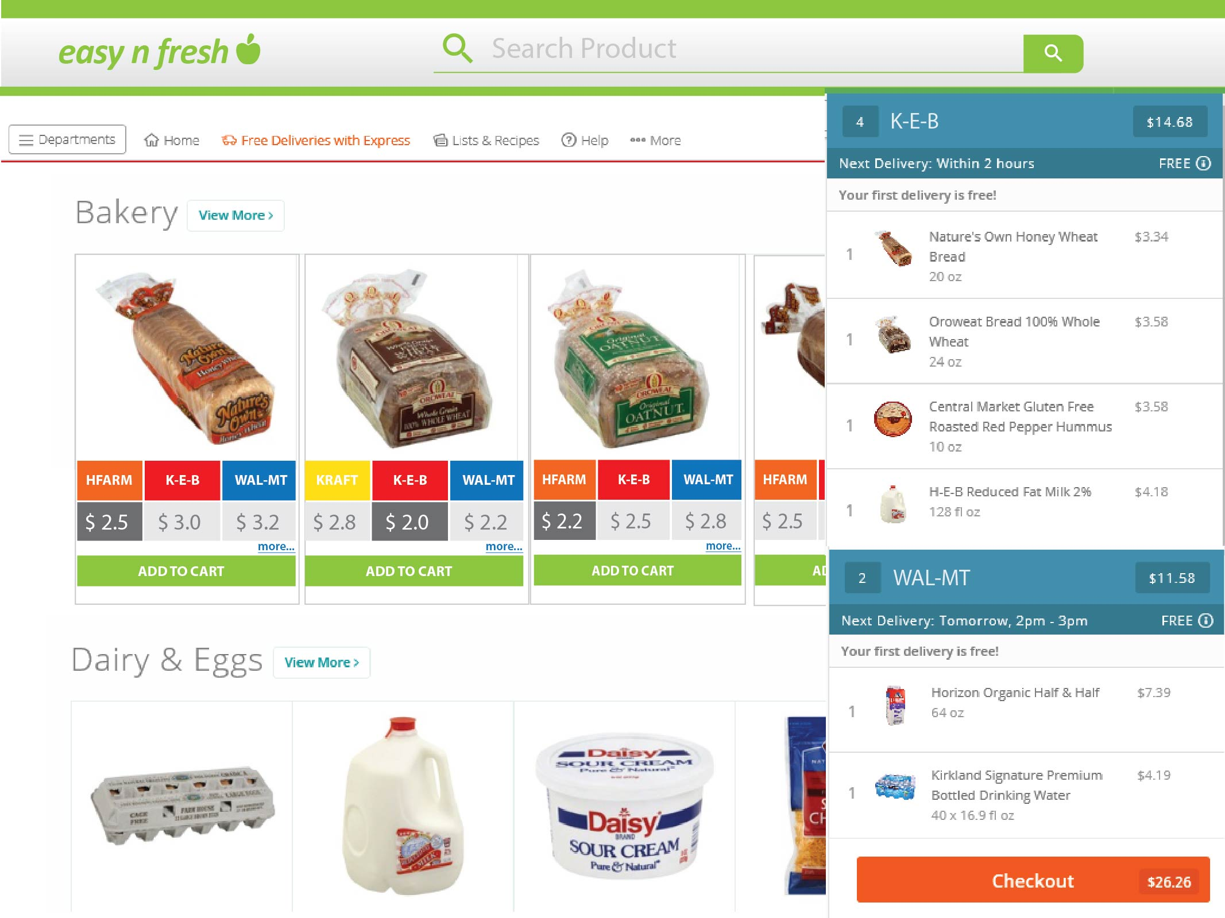

Slide 23
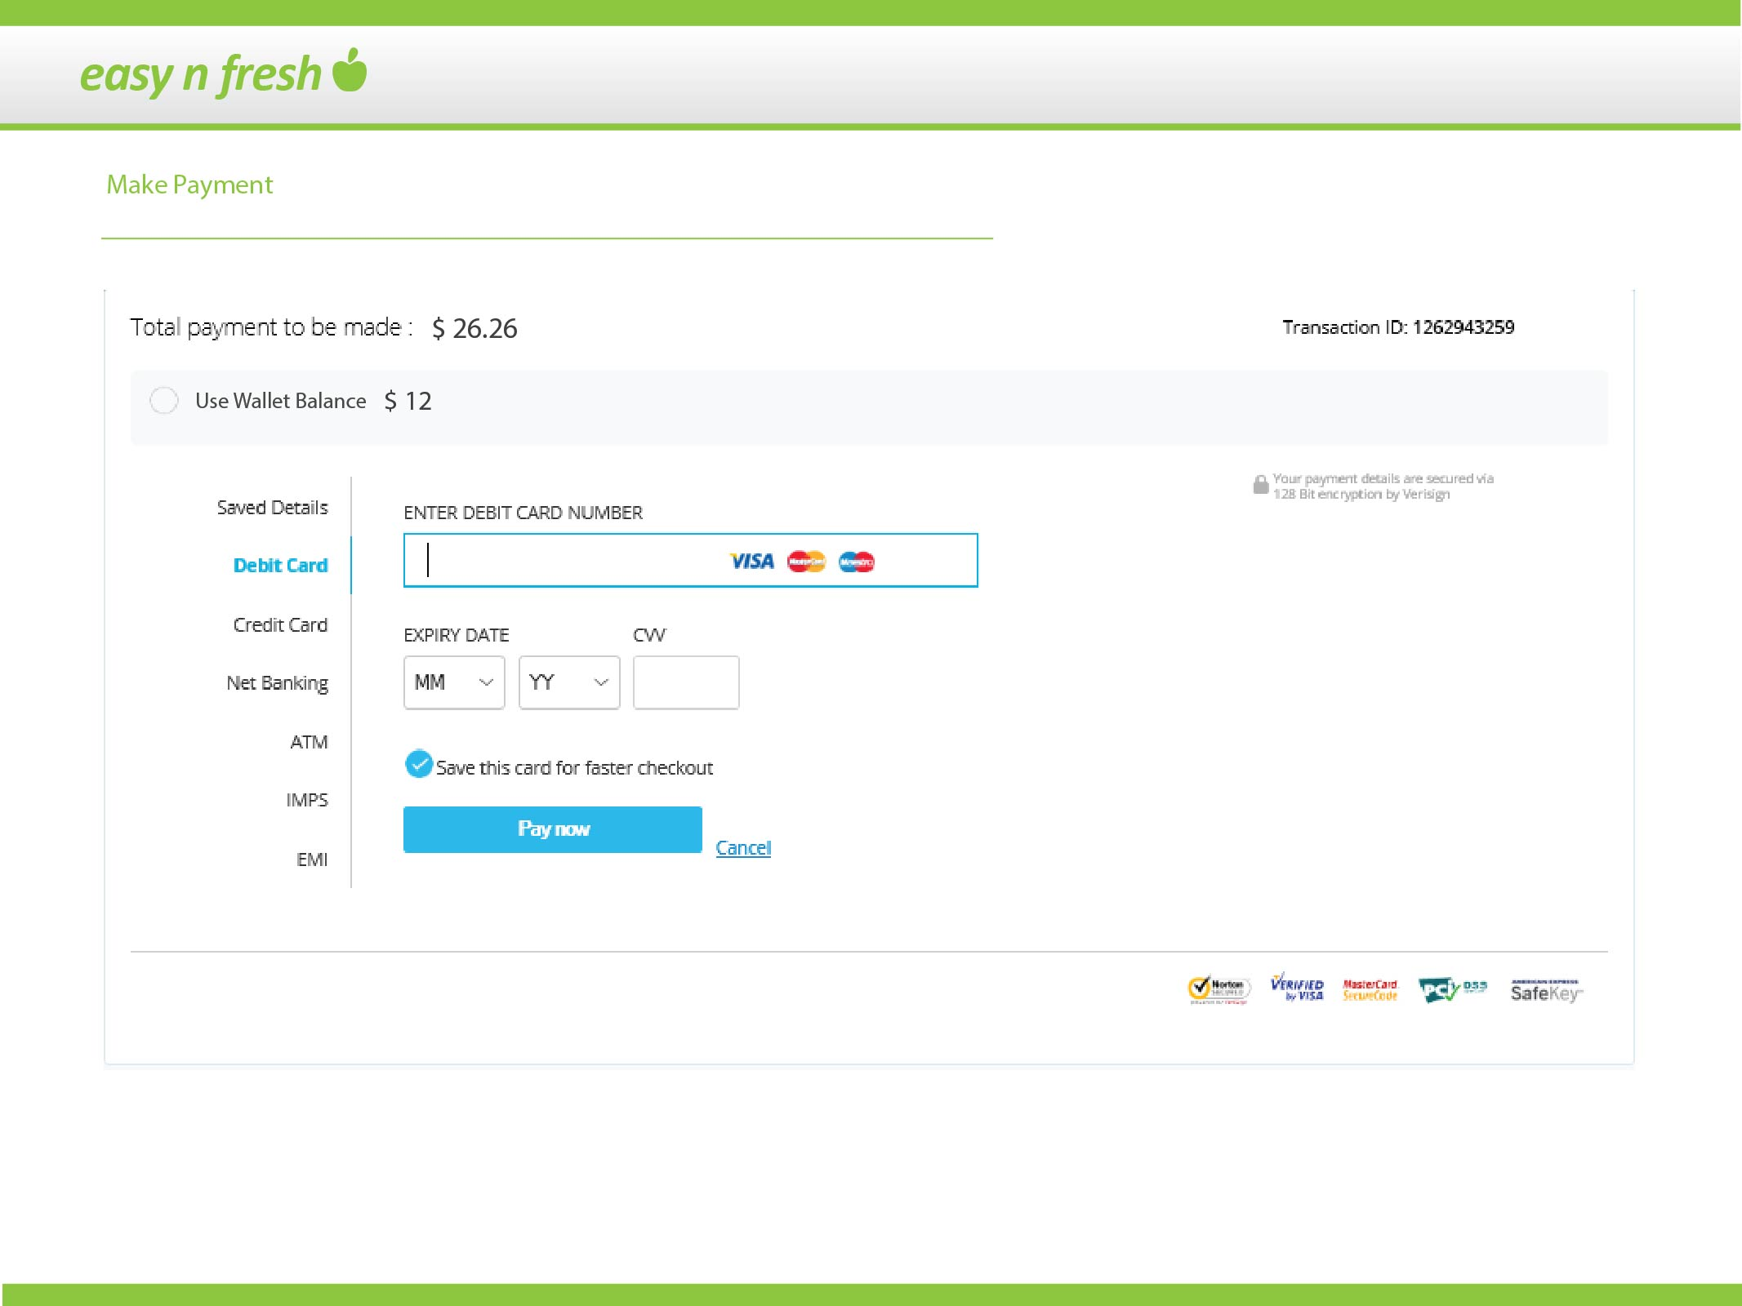

Slide 24
Vivek

Slide 25
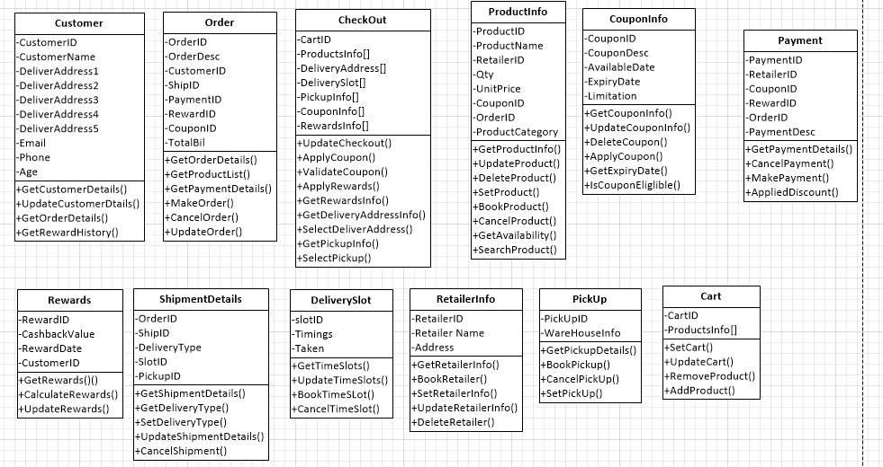
Class Diagram:

Slide 26
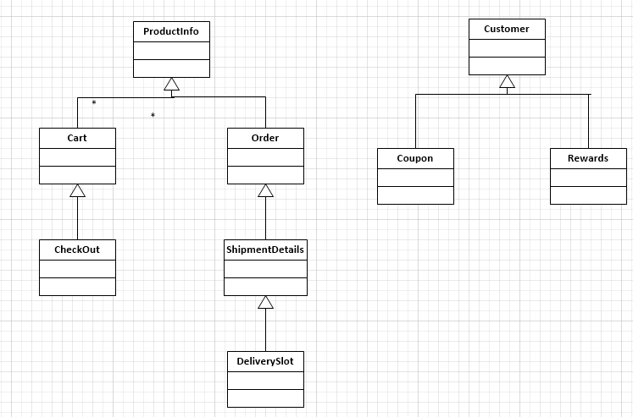
Generalization:

Slide 27
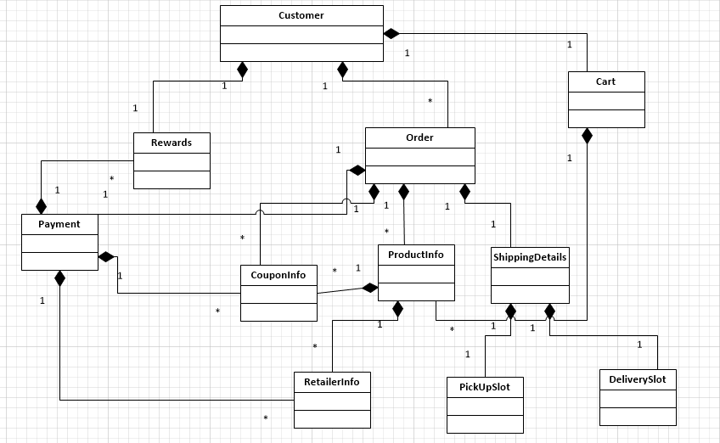
Aggregation:

Slide 28
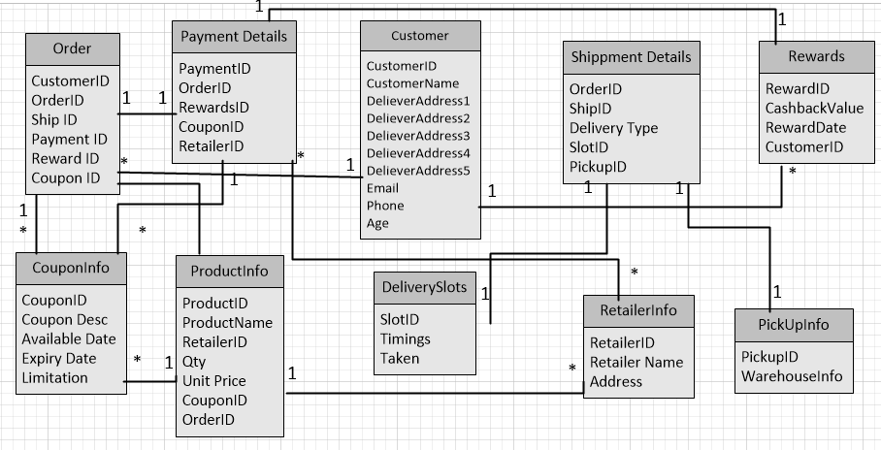
Database:

Slide 29
Benefits & Summary
Average person spends 5 hours a week in grocery shopping
Delivery of perishable goods.
Multiple retailers on a single platform.
Easy to find cheaper details.
Loyalty and cashback program.
Finding exclusive coupons for your order.
Flexibility of delivery and pick up option.

Slide 30
Learnings - Vivek
Operating Model
Opportunity to work on Visio
Time management
Working with diverse backgrounds of people
Better security measures.

Slide 31
Learnings - Sumit
Learnt Analysis and Design
Blending IT with business
Working with diverse backgrounds of people
Database design, UML models
Could Optimized the supply chain

Slide 32
Learnings - Kirthan
End to end perspectives
Gained retail domain experience
Learnt creating efficient designs
Project helped understand the team better
Ease of user interface to make system better.

Slide 33
Learnings – Saddam
Exposure towards business end
Gained e-commerce and retail domain experience
Multi Tasking
Working with diverse backgrounds of people
Could have used wish list concept.

Slide 34
Learnings – Sree Lakshmi
Business perspective
Attention to detail
Conflict management
Project Planning
More functionalities related to wallet

Slide 35
Thank you.

Slide 36
Questions ?

